Slide 1
Data Science
Business Required Document [BRD] – The Secret Sauce!

Slide 2
Tribe : A
Addanki Pallavi – Team Leader
Anshuman Kumar Tiwari
Bhargav Rohit
Dhriti Dogra
Jaswant Panigrahy
Pawan Kumar Patel
Polaki Siddharth
Rajat Kumar
Rohan Mule
Rohit Kumar Gupta
Shreyansh Malewar
Vaishnavi Chauhan

Slide 3


Data Science
Data science is an essential part of any industry today, given the massive amounts of data that are produced. Data science is one of the most debated topics in the industries these days. Its popularity has grown over the years, and companies have started implementing data science techniques to grow their business and increase customer satisfaction.
“Data really powers everything that we do.”

Slide 4
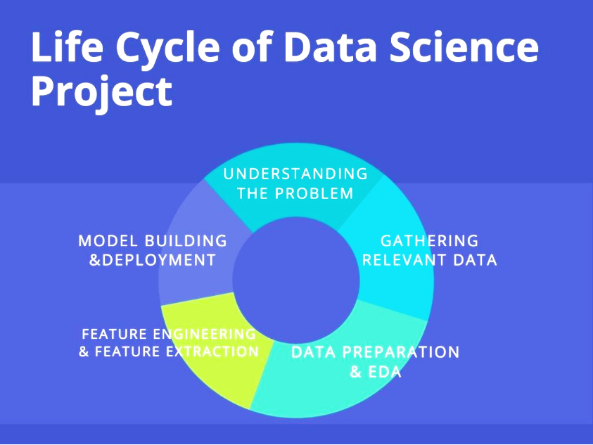
Data Science Life Cycle
A Data Science Life Cycle is nothing but a repetitive set of steps that you need to take to complete and deliver a project/product to your client. Although the data science projects and the teams involved in deploying and developing the model will be different, every data science life cycle will be slightly different in every other company. However, most of the data science projects happen to follow a somewhat similar process.
In order to start and complete a data science-based project, we need to understand the various roles and responsibilities of the people involved in building, developing the project. Let us take a look at those employees who are involved in a typical data science project:
Who Are Involved in The Projects:
Business Analyst
Data Analyst
Data Scientists
Data Engineer
Data Architect
Machine Learning Engineer

Slide 5
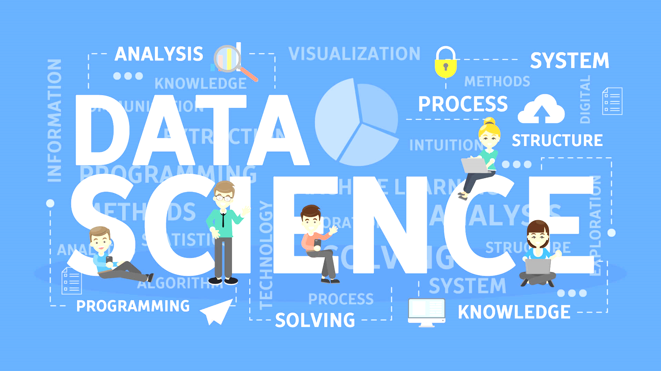
S
ummary
tatement
Project Requirement will combine some data set in a particular domain with some computational, statistical, or analytical technique to produce an interesting result, e.g. a model, a predictive model, a software system, or a visualization. The project will necessarily require the construction of software for data ingestion, wrangling, computation and analyses, and the production of a report or application. The final requirements include a demonstration of the software product created by the team as well as a short paper describing the system and it’s execution in terms of the data science pipeline.

Slide 6
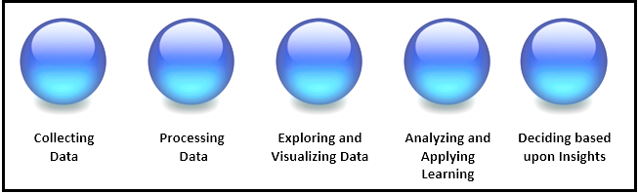
Project Objectives
Understand the Business
Get the Data
Explore and Clean the Data
Enrich the Dataset
Build Helpful Visualizations
Get Predictive
Iterate, Iterate, Iterate
Define The Business Impact
Connect Business Objectives to The Data
Clarify The Objective

Slide 7
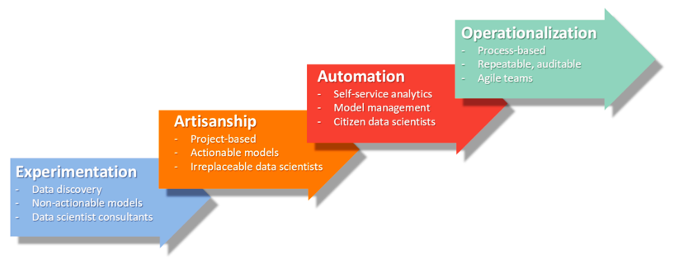
Needy-Need!
Data Science Projects helps organizations identify and refine target audiences by combining existing data with other data points for developing useful insights.

Slide 8
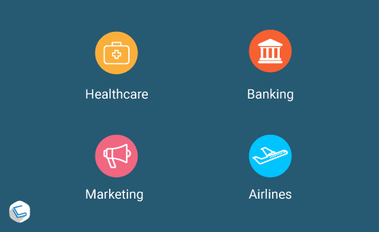
S C O P E
When we are working on a data science project, the project in a professional environment, it is likely to be an integral part of a more extensive setup. There may be people or teams that might get affected by the project or maybe are part of your team. A nicely laid out scope gives us a grip on the problem outlines and facilitates communications with stakeholders.
There are 4 Parts of a Data Project Scope as follows:
Context
Needs (the project is trying to fulfill)
Vision (of the achievement)
Outcome

Slide 9
The STD
Schedule
Timeline
Deadline
Each project is broken down into many small deliverable tasks that will given a short-time estimation. Deliverables are grouped into cycles. These small tasks will be pulled by team members until completion, trying to finish all tasks until the cycle ends. This helps to ensure that all stakeholders are aware of what is required and when it will be required.

Slide 10
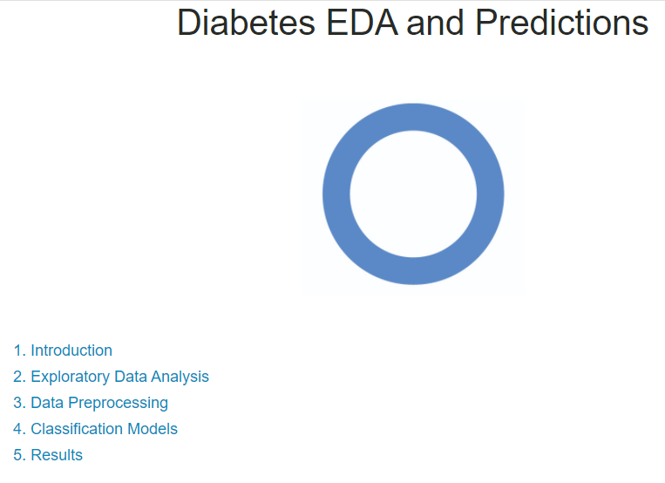
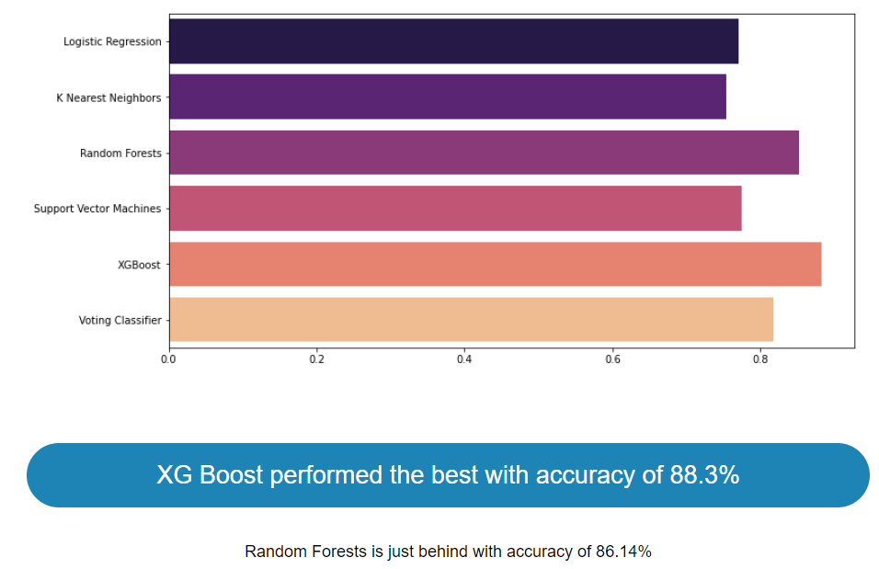
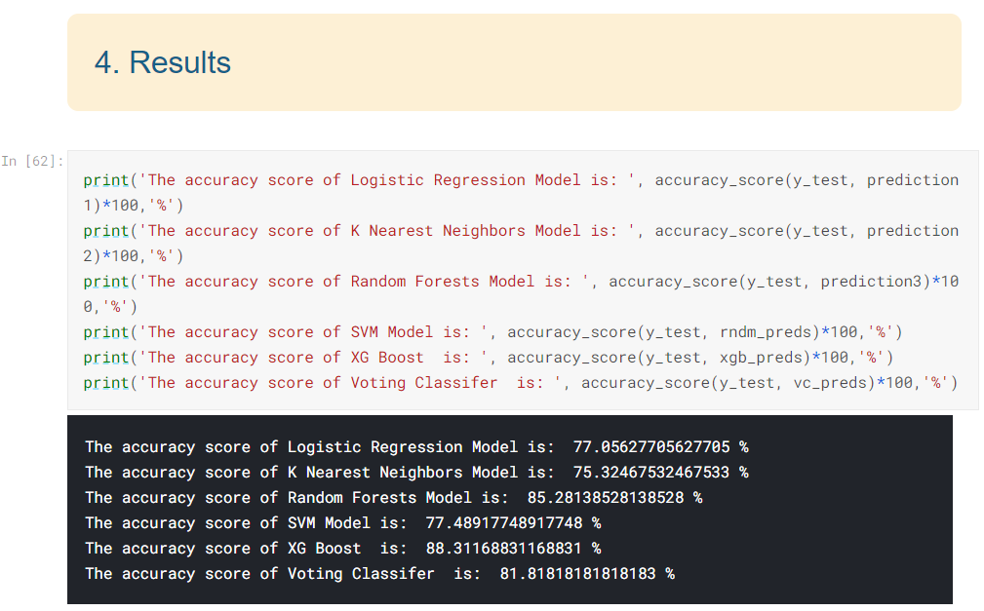
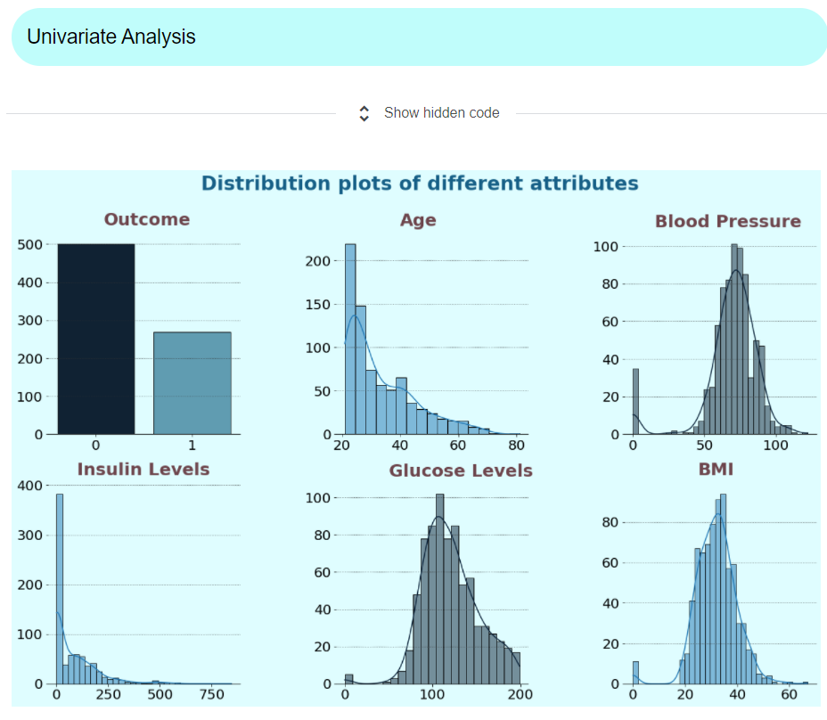
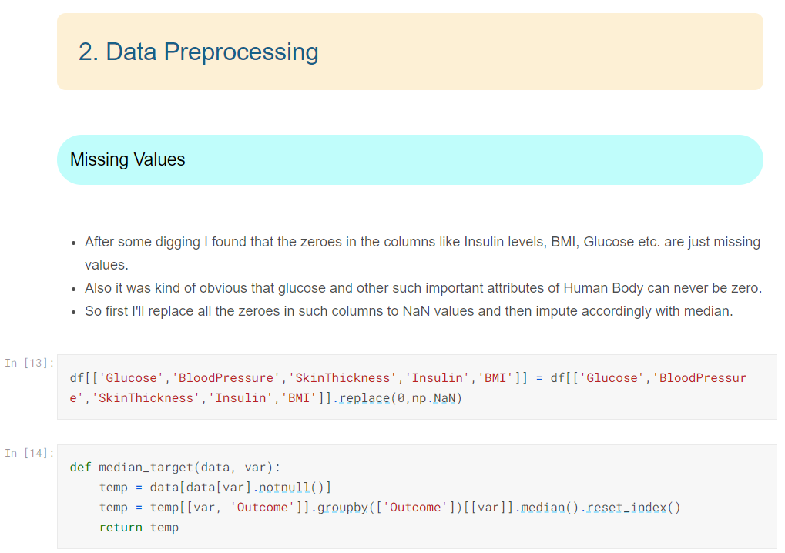

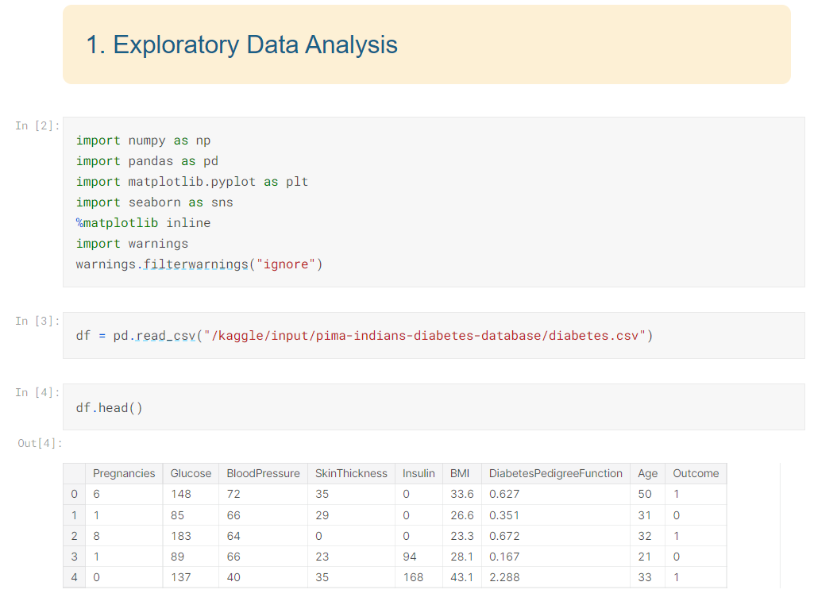
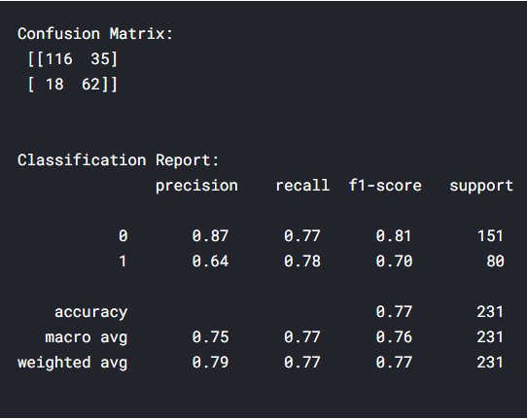
Assumptions

Slide 11

Deal with Data
Although it contains figures, statistics, and facts, unstructured data is usually text-heavy or configured in a way that’s difficult to analyze.
This is how we will work with the given data –
Working Together : Specializes in cleaning, sorting, or analyzing unstructured data that will automatically pasre, sort and analyze unstructured data in relatively new areas of development
Evaluate the Value of your Data, and Clean your Records : Not all unstructured data is worth analyzing, or even worth keeping. If the data are coming from a source that won’t yield much value for your organization, you should consider deleting it.
Take a Random Sample and Create a “Dictionary” : Analyzing the entire text file of your data manually is a virtually impossible task or at least an incredibly time-intensive one. Instead, it’s better to take a random sample or stratified sample from the collection, and use that to build a “dictionary” that you can use to find similar patterns in the rest of the data.
Clean the Entire Dataset : By using the framework you created from a random sample, you should be able to write a script that allows you to clean your entire dataset. Ideally, you’ll be able to classify and segment those data so you can analyze it easily in the future.
Analyze it : Assuming your data is properly structured and easy to digest, you can analyze those data and start making decisions based on the insights you gain. Once structured, you can treat your data like any other structured dataset you come across.

Slide 12
At the end, all that matters is: Process People Technology Product Materials and Supplies Facilities Machinery and Equipment Others as necessary (Depending on the Organization)

Slide 13






References -

